Slide 1
Contributions of MMT to the Theory of the Monetary Circuit
Warren Mosler
www.moslereconomics.com

Slide 2
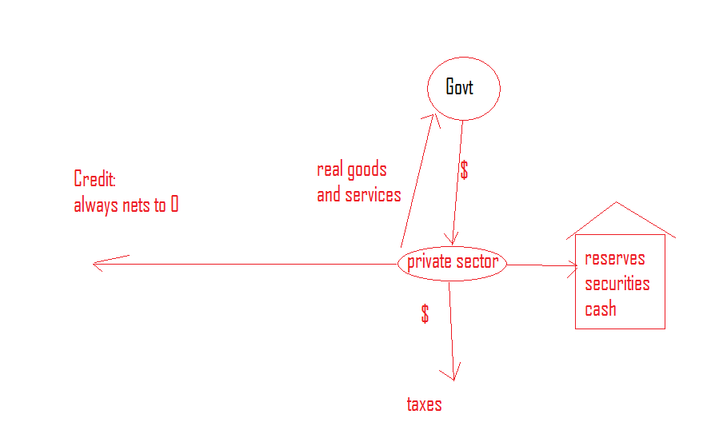
Horizontal and Vertical Components

Slide 3
The Monetary Circuit
Business borrow to buy inputs and pay labor
Wages and profits buy the output
Business retires borrowings
Flux and reflux
Then government is introduced
MMT begins with government
I called this the vertical component

Slide 4
Credit and the Monetary Circuit
Credit expansion in general is ‘horizontal’
Causation runs from loans to deposits
MMT: loans create both deposits and reserves

Slide 5
The Monetary Circuit (cont.)
The unanswered question is why anyone works in exchange for a unit of account with no intrinsic value.
Traditional responses assume value from an infinite regression.
MMT begins with the forces driving why anyone would work for the unit of account

Slide 6
MMT
The Currency is a (simple) public monopoly
That currency is necessarily not ‘neutral’
Monopolists are necessarily price setters
When monopolists restrict supply, the result is excess capacity

Slide 7
Government and the Vertical Component
The State is desirous of provisioning itself
The State levies a tax payable in its currency
This creates sellers of real goods and services seeking the needed currency.
Sellers of labor seeking the currency are defined of unemployed.

Slide 8
Spending and Unemployment
Government spending employs the unemployed created by the tax liabilities
If government spending isn’t sufficient to provide the funds needed to cover tax liabilities and savings desires, the result is unemployment.

Slide 9
Inflation
The currency monopolist is necessarily price setter
The price level is necessarily a function of prices paid by government when it spends, and/or collateral demanded when it lends

Slide 10
Savings Desires
Institutional demand leakages tend to force income not to be spent
Private sector credit expansion and government deficit spending fill the spending gap
Changes in private sector savings are generally the result of changes in private sector debt

Slide 11
Government and Unemployment
Government provisions itself to provide for public infrastructure
What sense does it make for government to create more unemployed through tax levies than it wants to employ?
For a given size government, there is a level of taxation that corresponds to full employment.

Slide 12
MMT
Federal spending is not (operationally) constrained by revenues.
Federal taxes function to regulate aggregate demand, and not to collect revenues per se.
Federal borrowing functions to support the term structure of interest rates, and not to collect revenues per se.

Slide 13
MMT (cont.)
Government spending is a matter of crediting transaction accounts at the central bank.
Government borrowing is a matter of debiting transactions accounts and crediting securities accounts at the central bank.
Paying back government borrowing is a matter of debiting securities accounts and crediting reserve accounts at the central bank.

Slide 14
MONETIZING THE ECONOMY
Taxes cause goods and services to be offered for sale
This causes a general desire to obtain that currency

Slide 15
MMT and Uncertainty
Uncertainty used to about why people use money
MMT says uncertainty is about why people save financial assets denominated in the government’s currency of issue

Slide 16
Full Employment and Price Stability
Current policy uses an unemployed buffer stock as a price anchor
MMT reveals the option and benefits of using an employed buffer stock as a price anchor

Slide 18
Contributions of MMT to the Theory of the Monetary Circuit
Warren Mosler
www.moslereconomics.com

